Slide 1



Slide 2
CLO1:
Data Understanding and Tools
Purpose of Data Analysis: The main goal is to understand student performance by analyzing factors like scores, gender, and education level. This helps identify patterns and relationships, predict future outcomes, and support students needing help.
Programming Justification: Python was chosen for its simplicity and powerful libraries.
Pandas: for organizing and analyzing data
Seaborn/Matplotlib: for clear, visual graphs
Scikit-learn: for applying machine learning models Python’s popularity in real-world data science makes it ideal for this educational analysis.

Slide 3
CLO1:
CLO1/ Identify Type and Purpose of Machine Learning Algorithm
This project used classification models—mainly Logistic Regression—to predict if a student would pass or fail, based on a newly added "pass" column calculated from average scores. Since the target was categorical, classification was the right approach. Additionally, regression models (Simple and Multiple Linear Regression) were applied to predict continuous scores like writing from reading. The focus on classification helped segment students based on performance rather than predict exact values.

Slide 4
CLO1: Identify and Justify Variables
Independent Variables:
Gender, Race/Ethnicity, Parental Education Level,
Lunch Type, Test Preparation Course, Reading Score,
Writing Score, Math Score.
Dependent Variable:
Pass or Fail (based on the average of reading, writing, and math scores).
The independent variables provide insights into student background and academic performance, which influence whether a student passes or fails.

Slide 5
CLO2:
Justify Descriptive Analysis
Descriptive analysis gives a first overview of the data.
Answers key questions like:
What is the average (mean) score?
Are there very high or very low scores?
How do scores vary across different groups?
Uses statistics like mean, median, mode, and standard deviation to understand student performance.
Helps identify outliers and clean data before modeling.
It forms the foundation for all further analysis in the project.

Slide 6

CLO2:
clO2/Develop Python Function for Descriptive Statistics (1000 student performance)

Slide 7
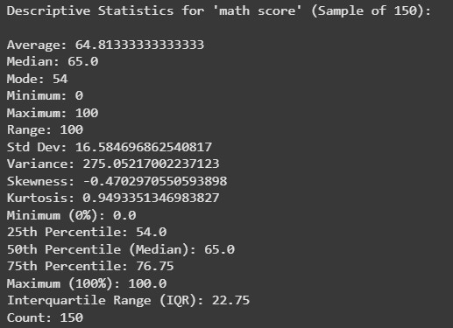
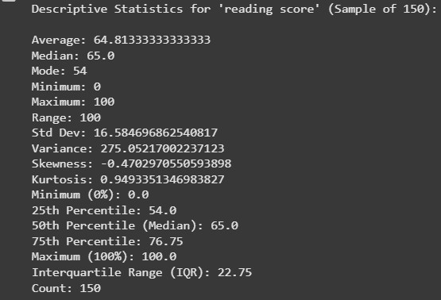
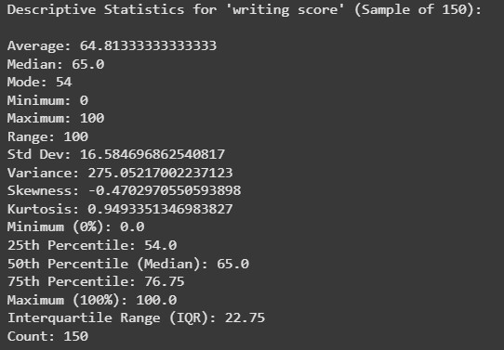
CLO2:
Random Sampling & Descriptive Stats for Dependent Variable

Slide 8
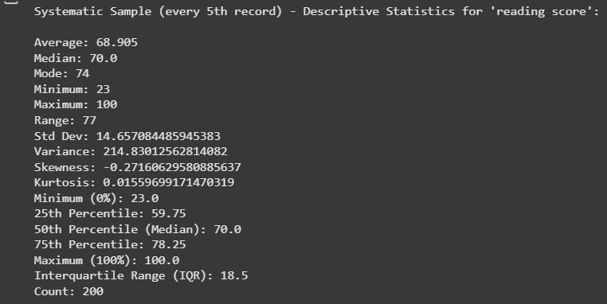
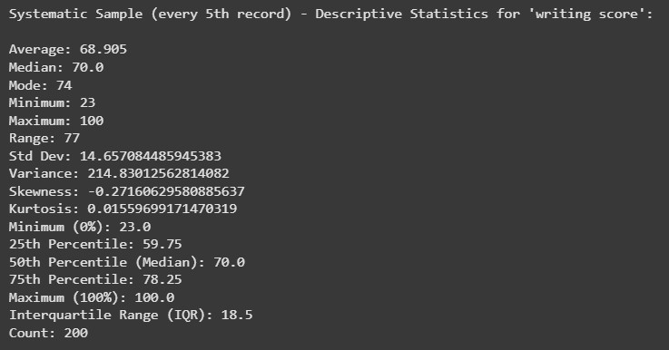
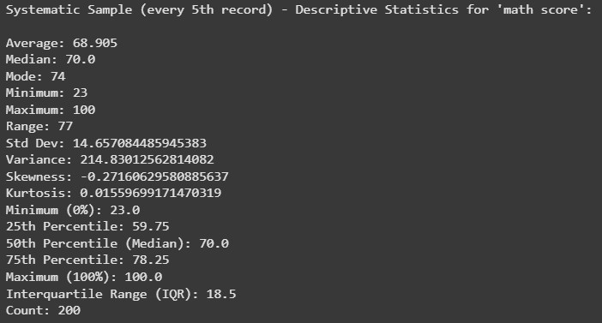
CLO2/Script for Systematic Sampling & Descriptive Stats ( 200 student)

Slide 9
CLO2/ Detailed Descriptive Stats Report for Dependent Variable
Reading, Writing, and Math scores:
Statistic | Value
Average | 68.91
Standard Deviation | 14.66
Range | 77
Interquartile Range (IQR) | 18.5
Skewness | -0.27
Kurtosis
Statistic | Value
Average | 64.81
Standard Deviation | 16.58
Range | 100
Interquartile Range (IQR) | 22.75
Skewness | -0.47
Kurtosis | 0.95
SYSTEMATIC SAMPLE (EVERY 5TH STUDENT, 200 STUDENTS)
Random Sample (150 Students)

Slide 10
Full Dataset (1000 Students) for Reading, Writing, and Math scores:
Statistic | Reading | Writing | Math
Average (Mean) | 69.17 | 68.05 | 66.09
Standard Deviation | 14.60 | 15.20 | 15.16
Range | 83 (17–100) | 90 (10–100) | 100 (0–100)
IQR | 20 | 21.25 | 20.0
Skewness | -0.26 | — | —
Kurtosis | -0.07 | — | —

Slide 11
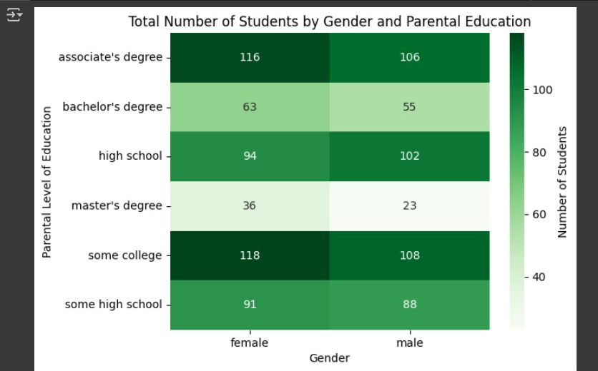
CLO2/ Visualize Dependent Variable Using Python Charts
Heat map: Students by Gender and Parental Education
Most students have parents with "some college" or "associate’s degree" education.
Female students slightly outnumber male students in most parental education categories.
This chart helps us easily see demographic patterns and where the largest student groups are.

Slide 12
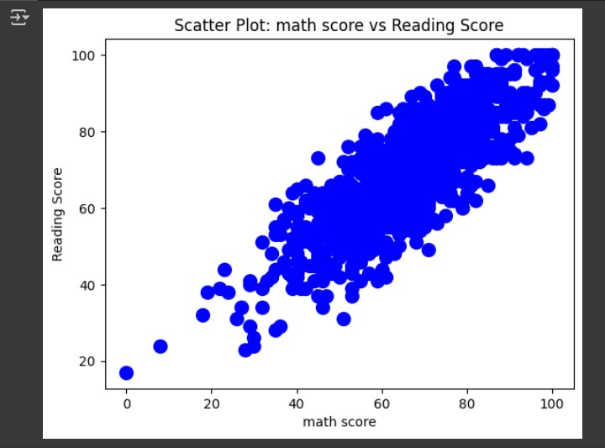
SCATTER PLOT
Scatter Plot: Math Score vs Reading Score
The scatter plot comparing math scores and reading scores.
Each dot represents a student’s math and reading scores.
There is a strong positive relationship: students who score high in math usually score high in reading too.

Slide 13
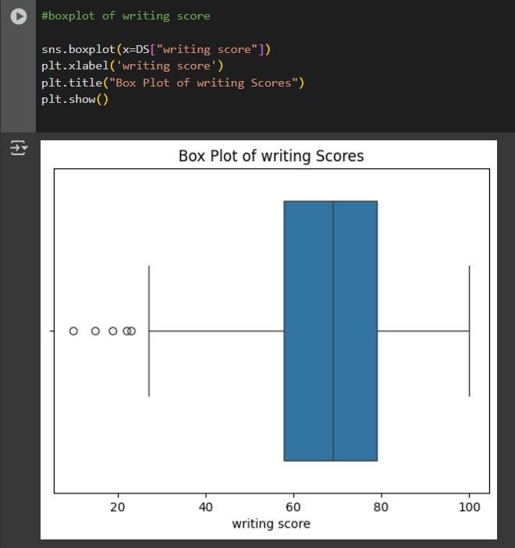
BOXPLOT
BOX Plot of writing Score
Most students scored between 60 and 80.
The middle line inside the box shows the median score, which is around 70.
There are a few outliers (points far from the rest) on the lower end, meaning some students scored much lower than the others.
The plot also shows the overall range of scores, from about 20 to 100.

Slide 14
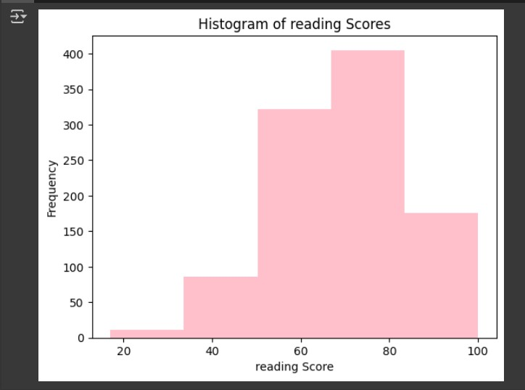
HISTOGRAM:
Histogram of Reading Scores
Most students scored between 60 and 80.
A smaller number of students scored below 40 or above 90.
The highest bar is between 70 and 80, meaning many students scored in this range.

Slide 15
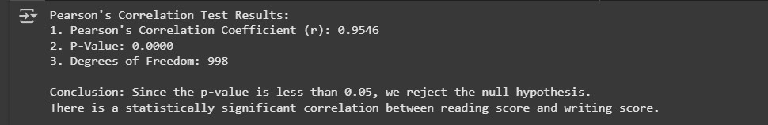
CLO2/ Perform Hypothesis Test for Correlation Between Variables
The Pearson's correlation test was performed to examine the relationship between reading and writing scores. The correlation coefficient (r) was found to be 0.9546, which indicates a very strong positive linear relationship between the two variables. Since the p-value is 0.0000, which is less than 0.05, we reject the null hypothesis. This means the relationship between readings and writing scores is statistically significant.

Slide 16
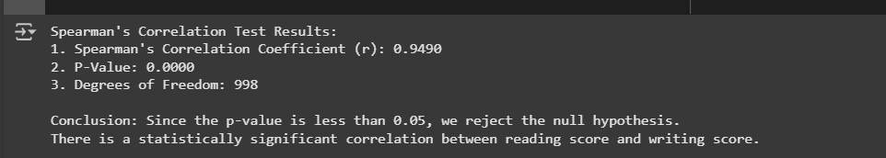
SPEARMAN:
The Spearman's correlation test was used to assess the relationship between reading and writing scores. The correlation coefficient (r) was 0.9490, indicating a strong positive relationship. The p-value of 0.0000 is less than 0.05, so we reject the null hypothesis. This means there is a statistically significant correlation between reading and writing scores.

Slide 17
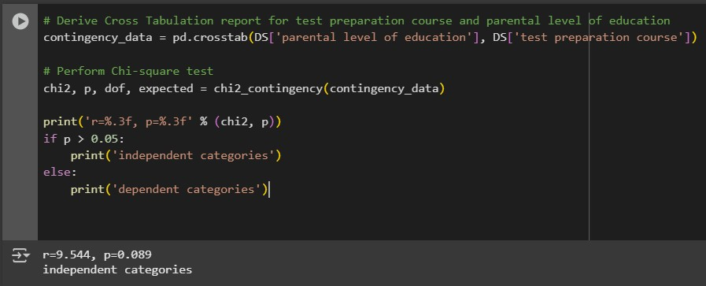
CHI-SQUARE:
The Chi-square test was conducted to determine if there is an association between the parental level of education and the test preparation course.
The p-value of 0.089 is greater than 0.05, so we fail to reject the null hypothesis. This means that there is no statistically significant association between parental education level and whether a student completed the test preparation course.

Slide 18
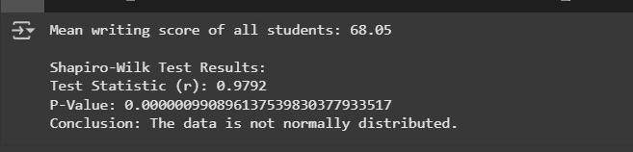
Assess Dependent Variable Performance Using One-Sample T-Test:
Shapiro-Wilk test: The mean writing score of all students is 68.05.
The Shapiro-Wilk test showed that the writing scores are not normally distributed (because the p-value < 0.05).

Slide 19
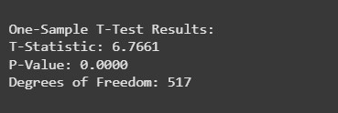
ONE-SAMPLE T-TEST
However, since the sample size is large (518 students), we can still continue with the One-Sample T-Test based on the Central Limit Theorem.
Meaning: Even though the data is not perfectly normal, a large sample makes the t-test results trustworthy and reliable.
Since the p-value is less than 0.05, we reject the null hypothesis.
The average writing score of female students is significantly different from the average writing score of all students.

Slide 20
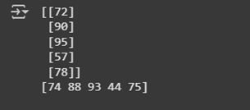
CLO3/ Build, Train, Develop and Evaluate using Simple Regression for chosen dataset
Reading scores are from [72, 90, 95, 57, 78] on the simple linear regression, while writing scores are 74 to 75 on the same scale. higher writing scores tend to correlate with higher reading scores, showing a generally positive trend. The data is suitable for simple regression analysis since this points to a possible linear relationship.

Slide 21
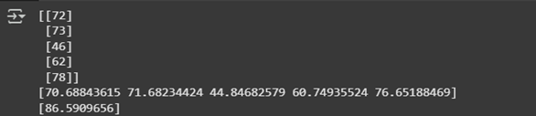
PREDICTING WRITING SCORE FROM READING SCORE
It predicts writing scores based on reading scores using a Simple Linear Regression model. After training, it predicts the test set's writing scores, displaying the first five predictions for the reading scores [72, 73, 46, 62, 78] and the writing scores [70.69, 71.68, 44.85, 60.75, 76.65]. For a reading score of 88, the model also predicts a writing score of about 86.59.

Slide 22
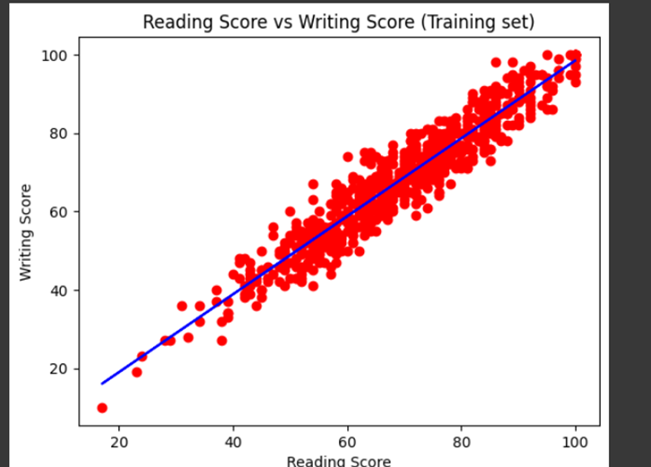
Reading vs. Writing Scores Visualization (Training Set)
The relationship between the training dataset's writing and reading scores is displayed by the code. It adds a blue regression line on top of a scatter plot with red dots representing individual data points. greater reading scores usually correlate with greater writing scores, according to the graph, suggesting a strong predictive relationship.

Slide 23
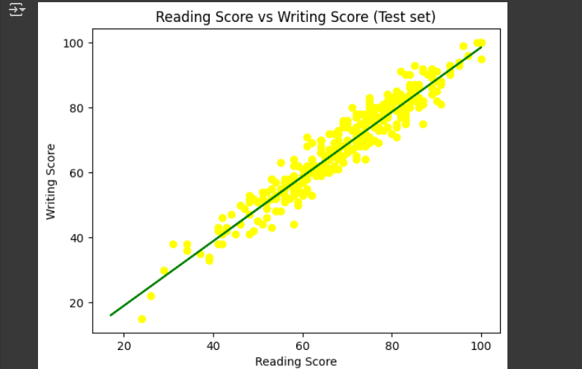
Reading vs. Writing Scores Visualization (Test Set)
The individual test data points are represented by yellow dots in the scatter plot that is generated (X_test for reading scores and y_test for writing scores). The shown writing scores based on the training set's reading scores are displayed by placing a green regression line.

Slide 24
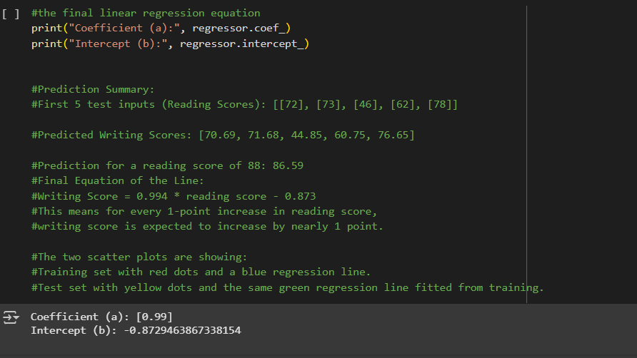
Final linear Regression Equation
The coefficient shows a strong positive correlation, proving that the writing score rises by almost 0.99 points for every increased reading score point. The intercept indicates a slight negative value, which may not be meaningful in the context of this model since reading scores typically do not reach zero.

Slide 25
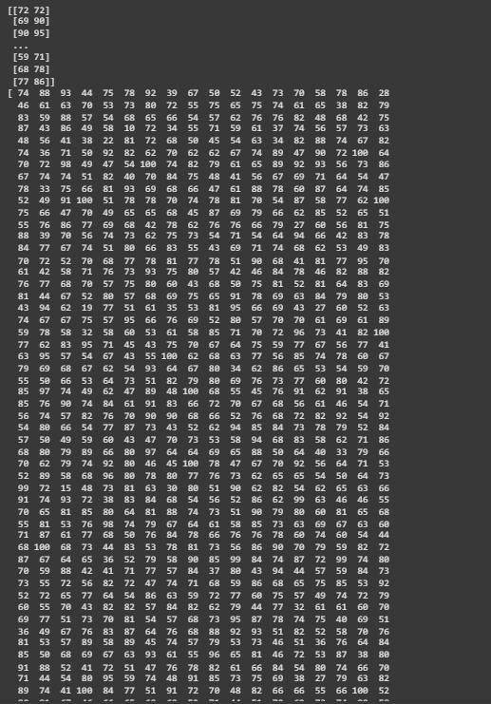
CLO3/Develop a script to forecast the value of the dependent variable from all the relevant independent variables using multiple linear regression.
Extracting Independent and Dependent Variables
The writing score (index 7) is the dependent variable, while the math and reading scores (index 5) are the independent variables. The variables X and Y, respectively, hold the extracted values.

Slide 26
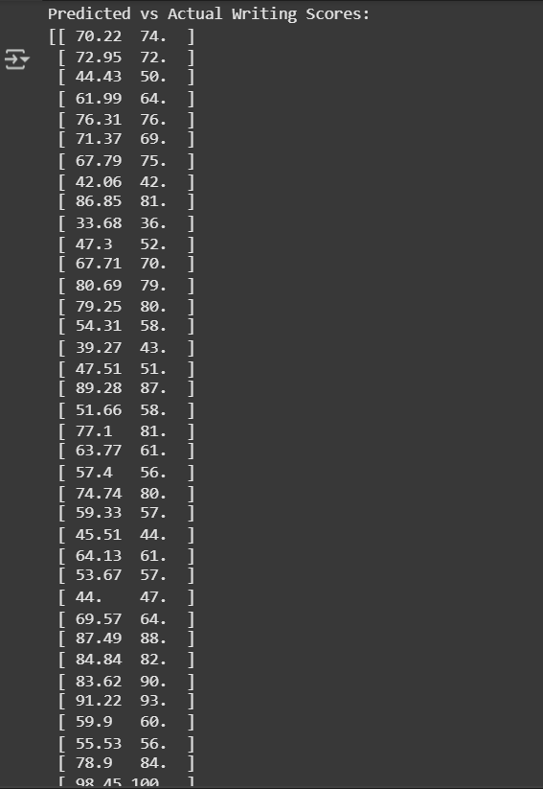
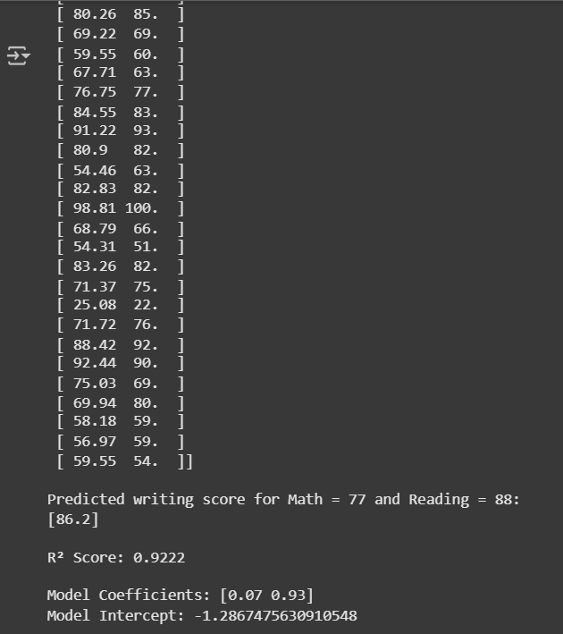
Training and Evaluating Multiple Linear Regression Model
The model explains approximately 92.22% of the variance in writing scores based on math and reading scores, according to the R2 score of 0.9222, which shows a strong match. According to the coefficients, writing scores are more significantly impacted by reading scores compared by math results.

Slide 27
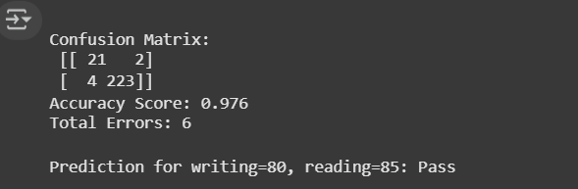
clo3/Predict the value of the dependent variable from the different classifier such as Logistic Regression, KNN, Naïve-Bayes and Decision Tree
Logistic Regression
The model achieves an accuracy of 97.6%, indicating strong predictive performance. The confusion matrix shows a high number of true positives and true negatives, with only a few misclassifications. The individual prediction suggests that a student with scores of 80 in writing and 85 in reading is expected to pass.

Slide 28
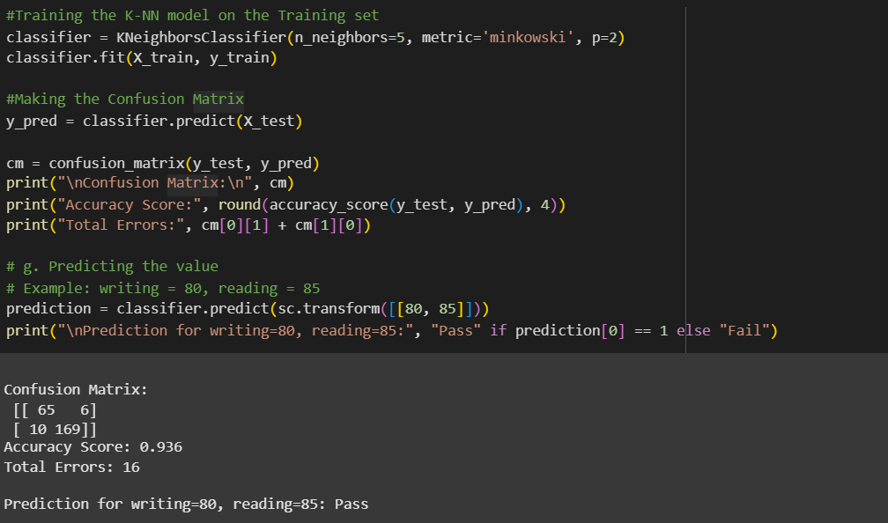
K-Nearest Neighbors (K-NN)
The model performs well with an accuracy of 93.6%. With most predictions being accurate, the confusion matrix displays a very low number of misclassifications. According to the individual prediction, a student should pass if their writing and reading scores are 80 and 85.

Slide 29
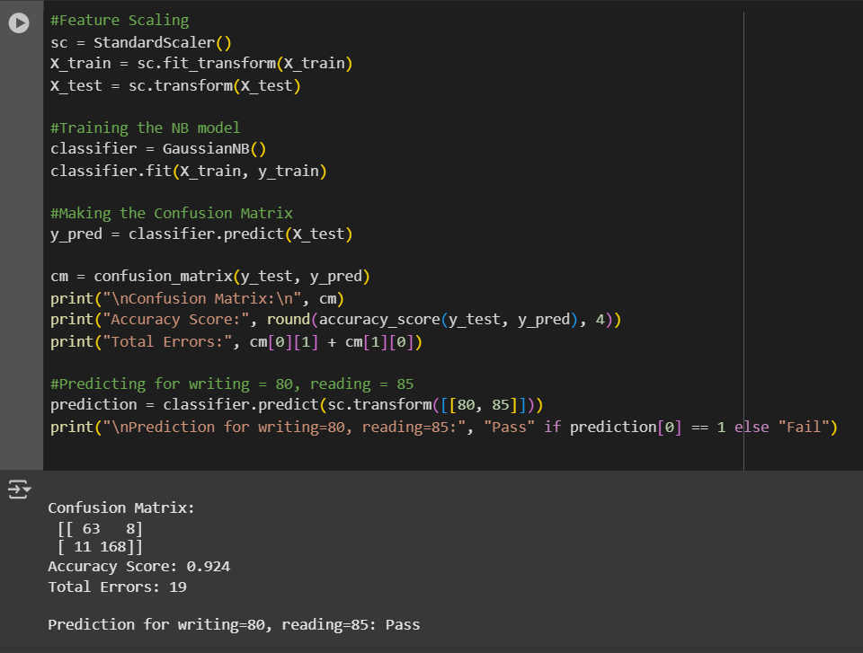
Naïve Bayes (NB)
The model achieves an accuracy of 92.4%, indicating strong predictive performance. The confusion matrix shows a relatively small number of misclassifications, with most predictions being correct. The individual prediction suggests that a student with scores of 80 in writing and 85 in reading is expected to pass.

Slide 30
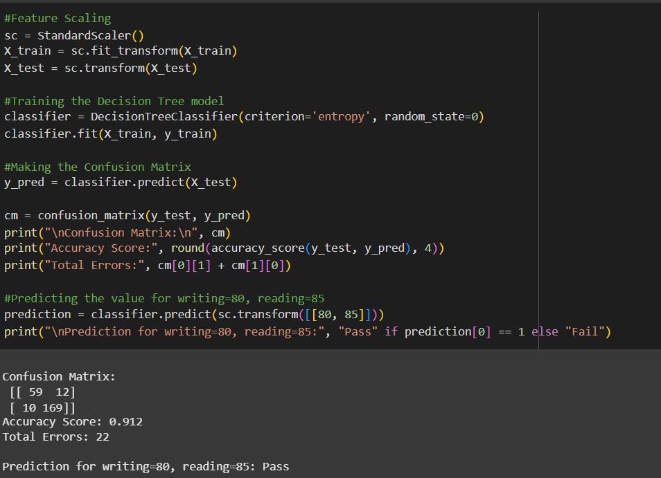
Decision Tree (DT)
The model achieves an accuracy of 91.2%, indicating a good predictive performance. The confusion matrix shows a moderate number of misclassifications, with most predictions being correct. The individual prediction indicates that a student with scores of 80 in writing and 85 in reading is expected to pass.

Slide 31
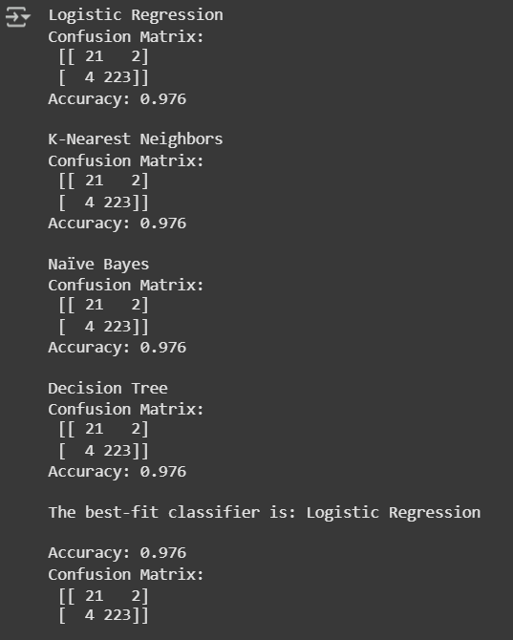
CLO 3 /Evaluate the performance of each model using confusion matrix and accuracy and identify the best fit classifier for the chosen dataset.
Every model performed very well, achieving the same accuracy of 97.6%. Based on the given metrics, all models performed equally well, although the Logistic Regression model is identified as the best-fit classifier.

Slide 32
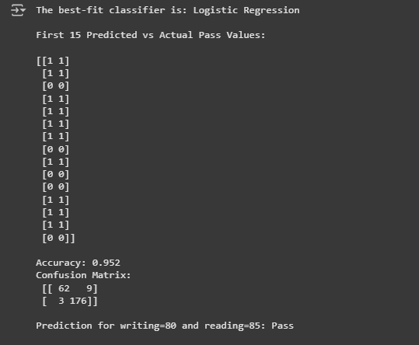
CLO3 - Predict the dependent variable by using best-fit classifier.
our project uses logistic regression to predict if the student will fail or pass in math based on reading and writing scores . our data is split into two part: training and testing , and the scores are standarized. we notice that the model reaches an accuracy of 95.2% , which means it performs very well . the confusion matrix shows us the total of correct and incorrect predictions , also the program could predicts the new student with reading = 85 and writing = 80 will pass .

Slide 33
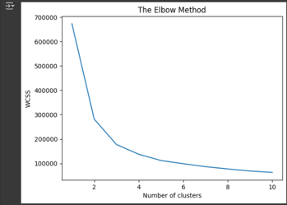
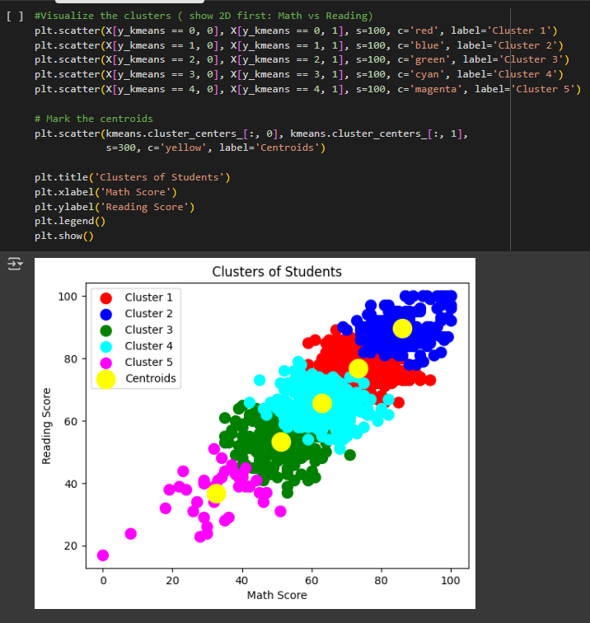
Perform the cluster analysis such as K-means and Horizontal for any field from the chosen dataset.
The output uses colors to show the number of students in different conditions, helping us plan support for them.
Elbow Method: Helps find the number of clusters by measuring WCSS (how close data points are). Lower WCSS means better clustering.
Cluster Graph: Shows student groups in different colors. The largest group is Cluster 5.

Slide 34
Explain the strategy for improving the system after viewing the cluster diagram.
Improving the System:
We can use the clusters to support students based on their scores.
Students with low scores will get more help.
Average students will get normal practice.
High-scoring students will get advanced materials.
This will help all students improve their performance.

Slide 35
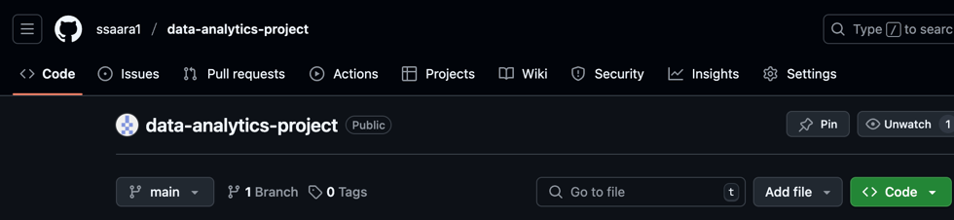
CLO4-Complete narration about data versioning using Git
Create a new repo for project in Git Hub:
We created a new GitHub repository called data-analytics-project using my account ssaara1. I chose to make it public so anyone can see it. This repository will help me manage and share my project files easily.
Here is the link to our repo: https://github.com/ssaara1/data-analytics-project.git or git@github.com:ssaara1/data-analytics-project.git .

Slide 36
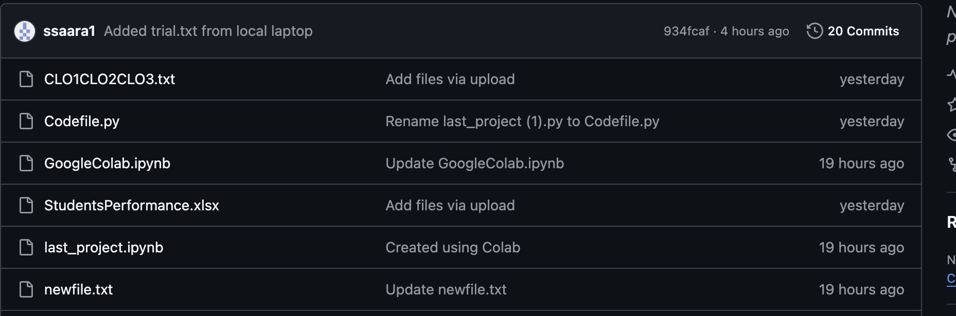
Upload all the project files created for CLO1,CLO2 and CLO3 to the Git Hub repo
After creating the GitHub repository data-analytics-project, I uploaded all my project files. These included the CLO1, CLO2, and CLO3 reports as .txt files, the Python code as .py files, the Google Colab notebook, and the Excel file we used in the project.

Slide 37
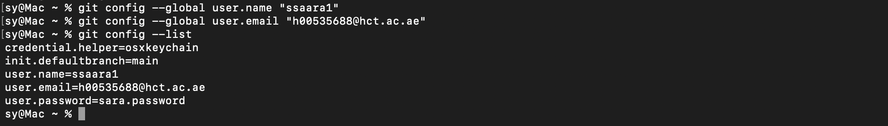
Configure Git with GitHub
I connected Git with my GitHub account by setting my username and email in the terminal. I used commands to set my name as ssaara1 and my email as h00535688@hct.ac.ae. Then I checked everything using git config --list, and it showed my Git setup details.
git config --global user.name "ssaara1"
git config --global user.email "h00535688@hct.ac.ae"

Slide 38
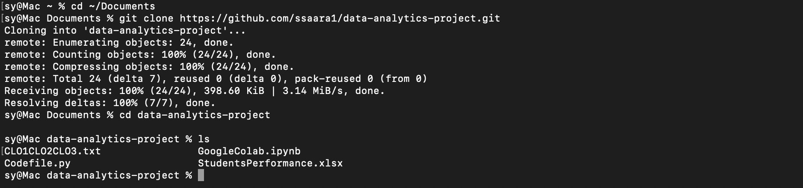
Clone Git hub repo to Git
I cloned my GitHub repository to my laptop by going to the Documents folder in the terminal and running this command:
(git clone https://github.com/ssaara1/data-analytics-project.git)
Then I went into the project folder using cd data-analytics-project and checked that all the files were there. I wrote ls in the terminal to list the files.

Slide 39
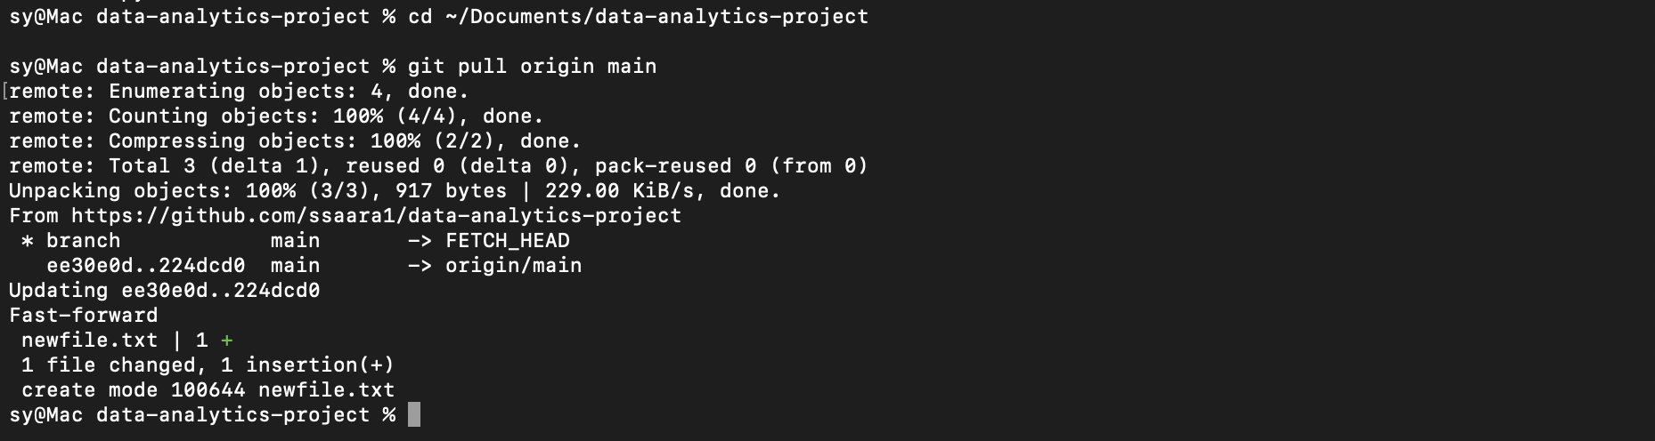
Pull any file from Git Hub repo to Git
I created a file called newfile.txt on GitHub. Then, on my laptop, I used the command:
git pull origin main
This pulled the latest changes from GitHub, and I saw that newfile.txt was added to my local project folder.

Slide 40
Modify the pulled file and push the modified file to Git Hub
I updated my local project by running git pull origin main. Then I created a new file on my laptop called trial.txt, added content, and moved it into my project folder. I added the file using:
git add trial.txt
git commit -m "Added trial.txt from local laptop
git push origin main
This pushed the new file to my GitHub repository, successfully updating it with the new file I added from my laptop.
----->

Slide 41
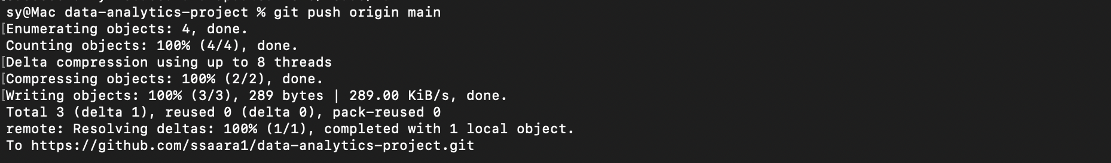

Slide 42
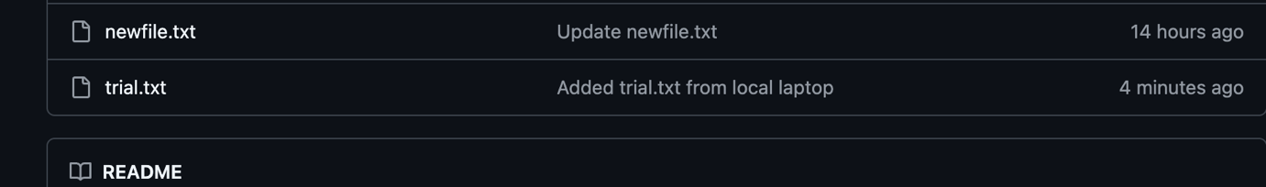
Its added successfully it says here (added from local laptop)

